Slide 1

On-ramp Guide
MSIX App Attach

Slide 2
MSIX Image Creation with MSIXMGR Tool
What is MSIX App Attach?
MSIX app attach is a way to deliver MSIX applications to both physical and virtual machines.
In simple words, it allows you to attach apps to the OS. Read more: What does MSIX App Attach do?
What is the MSIXMGR tool used for?
MSIXMGR takes an MSIX packaged application (.MSIX) and expands it into an MSIX image (VHD | VHDX | CimFS). That resulting MSIX image (.VHD(x) | CimFS) is what we upload to a storage account/file share in your AVD Deployment .
.msix
.VHD(x)/CimFS
AVD
expand
upload

Slide 3
1. A functioning Azure Virtual Desktop (AVD) deployment Azure Virtual Desktop MSIX app attach portal - Azure | Microsoft Learn 2. A list of MSIX apps if your apps are not in MSIX format: - Refer to the On-Ramp Guide on MSIX Packaging Tool to convert apps to .msix - 3. Download MSIXMGR Tool Use will need administrative permissions on the machine where you'll create the MSIX image
Prerequisites

Slide 4


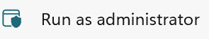
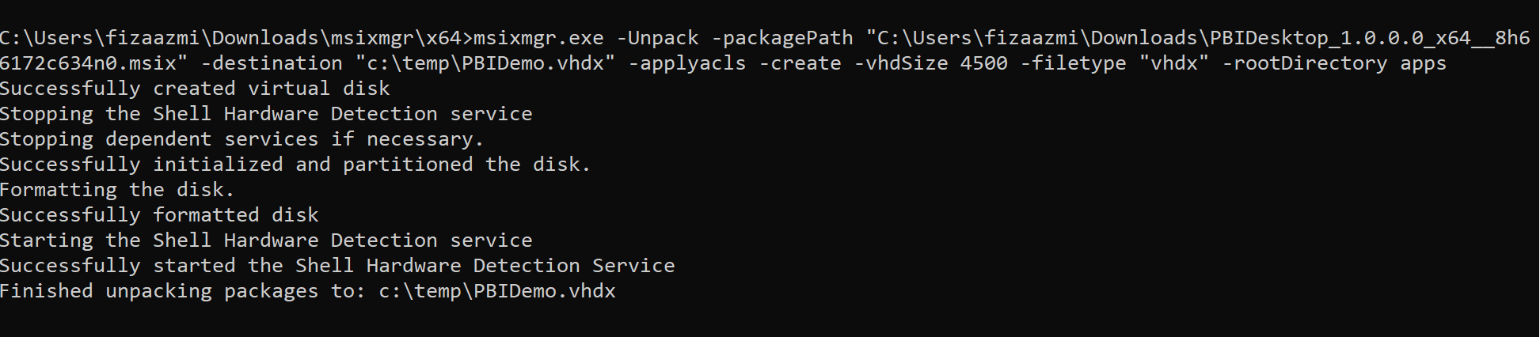
Using MSIXMGR Tool
Post downloading, unzip the .
Copy the location of the unzipped folder
Open a Command Prompt in elevated mode
Navigate to the folder location copied in step 2.
Create a temp folder in C Drive. This is destination where the vhdx will be created.
Run the following command to unpack
msixmgr.exe -Unpack -packagePath <path to package> -destination <output folder> [-applyacls] [-create] [-vhdSize <size in MB>] [-filetype <CIM | VHD | VHDX>] [-rootDirectory <rootDirectory>]
Example:

Slide 5
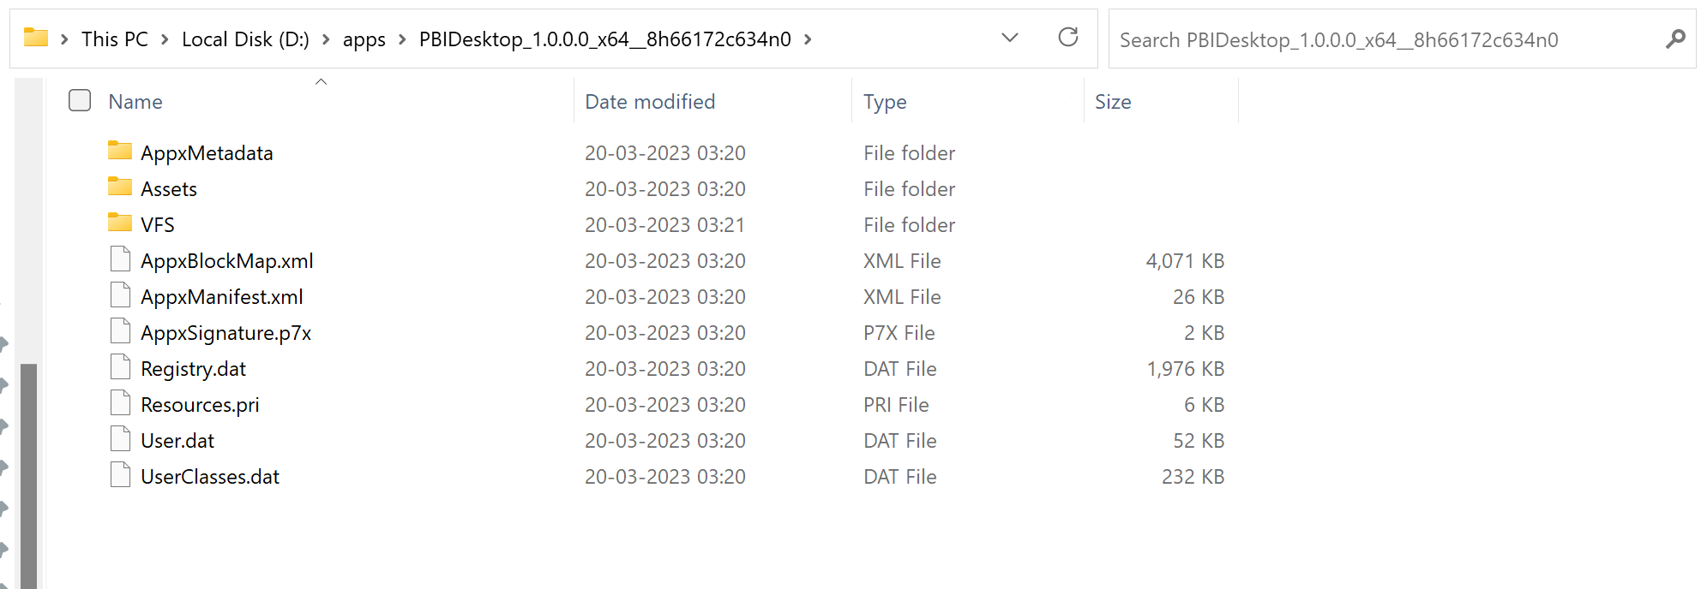
Using MSIXMGR Tool
Now that you've created the image, go to the destination folder and make sure you successfully created the MSIX image (.VHDX).

Slide 6

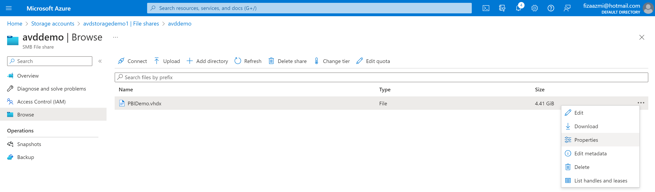
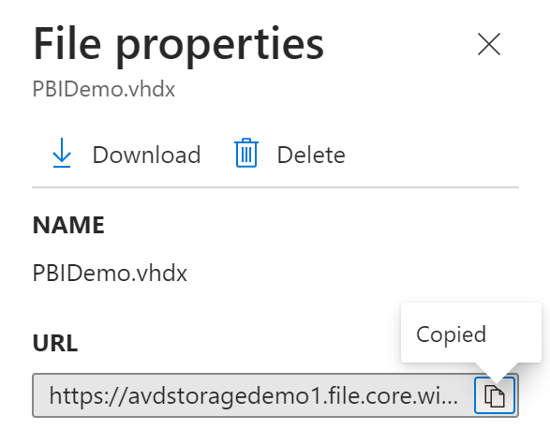
Navigate to Azure Portal
Open portal.azure.com > Storage accounts > File shares >Select the fileshare > - Upload the MSIX Image created earlier.
2. Go to Properties and copy Share URL:

Slide 7
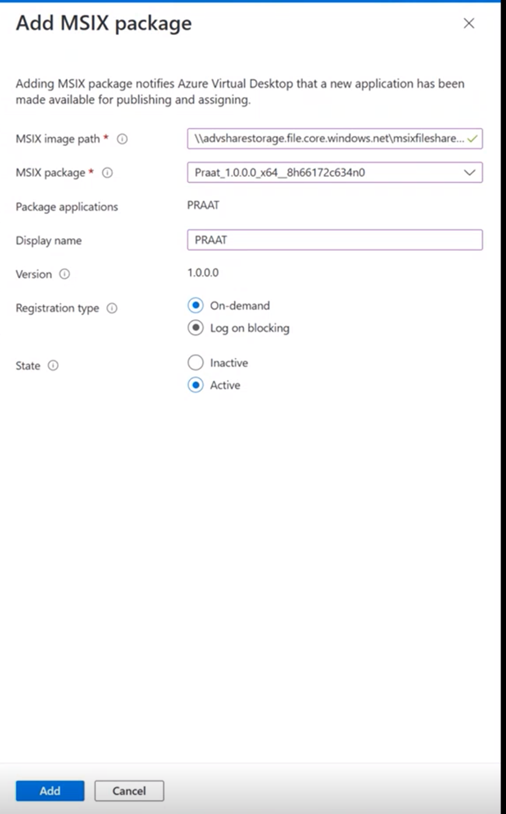

Navigate to Azure Portal
Now go to Azure Virtual Desktop > Host pools> Select the Host Pool where you want to put the MSIX Apps
Under Manage section > MSIX packages >
Paste the MSIX Image Path and select Add to interrogate the MSIX container to check if the path is valid
For Package applications, make sure the list contains all MSIX applications you want to be available to users in your MSIX package.
Optionally, enter a Display name if you want your package to have a more user-friendly in your user deployments.
Make sure the Version has the correct version number.
Select the Registration type you want to use depending on your needs:
- On-demand registration postpones the full registration of the MSIX application until the user starts the application. This is the registration type we recommend you use.
- Log on blocking only registers while the user is signing in. We don't recommend this type because it can lead to longer sign-in times for users.
8. . For State, select your preferred state.
- The Active status lets users interact with the package.
- The Inactive status causes Azure Virtual Desktop to ignore the package and not deliver it to users.
.

Slide 8
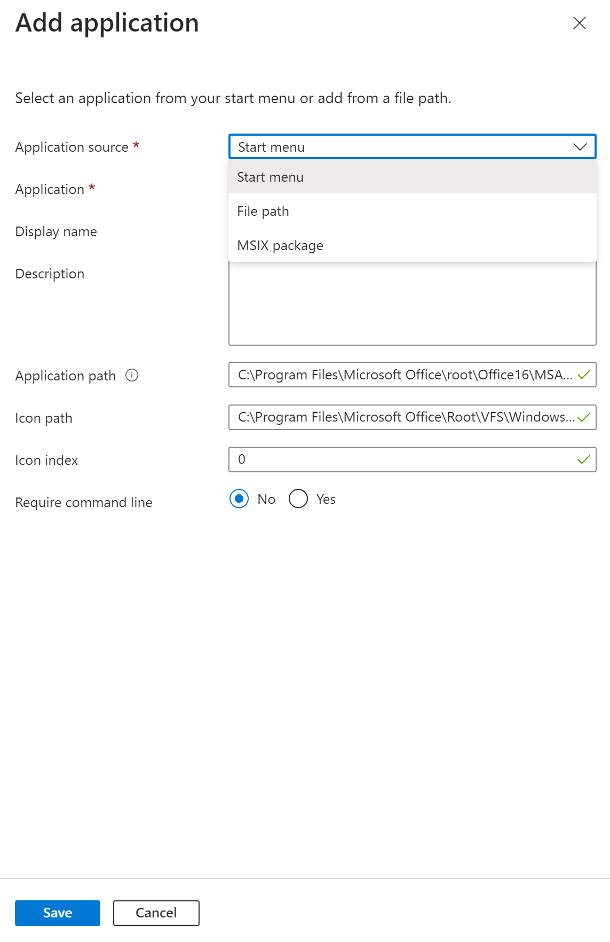
Publish MSIX apps to an application group
Navigate to Azure Virtual Desktop > Application groups > Select application group you want to publish the app to
Under Manage, go to Applications > Add application
Select Application source as MSIX package
For Application name, enter a descriptive name for the application
For Display name, enter a new name for the package that your users will see.
For Description, enter a short description of the app package.
If you're using a remote app group, you can also configure these options:
Icon path
Icon index
When you're done, select Save. 9. Assign users to the App group > Access Control (IAM) > Role assignments
10. Go to session hosts > Restart Virtual Machine

Slide 9
Remote Desktop Login

Slide 10
Connect with us
Join the MSIX Tech Community
Share your Feedback
Submit Feedback on MSIXMGR Tool or App Attach
Submit Ideas and Feature Requests for MSIX App Attach
Start a discussion here

Slide 11

On Ramp kit for MPT and PSF.docx (sharepoint.com)
MSIX Packaging Tool

